Slide 1
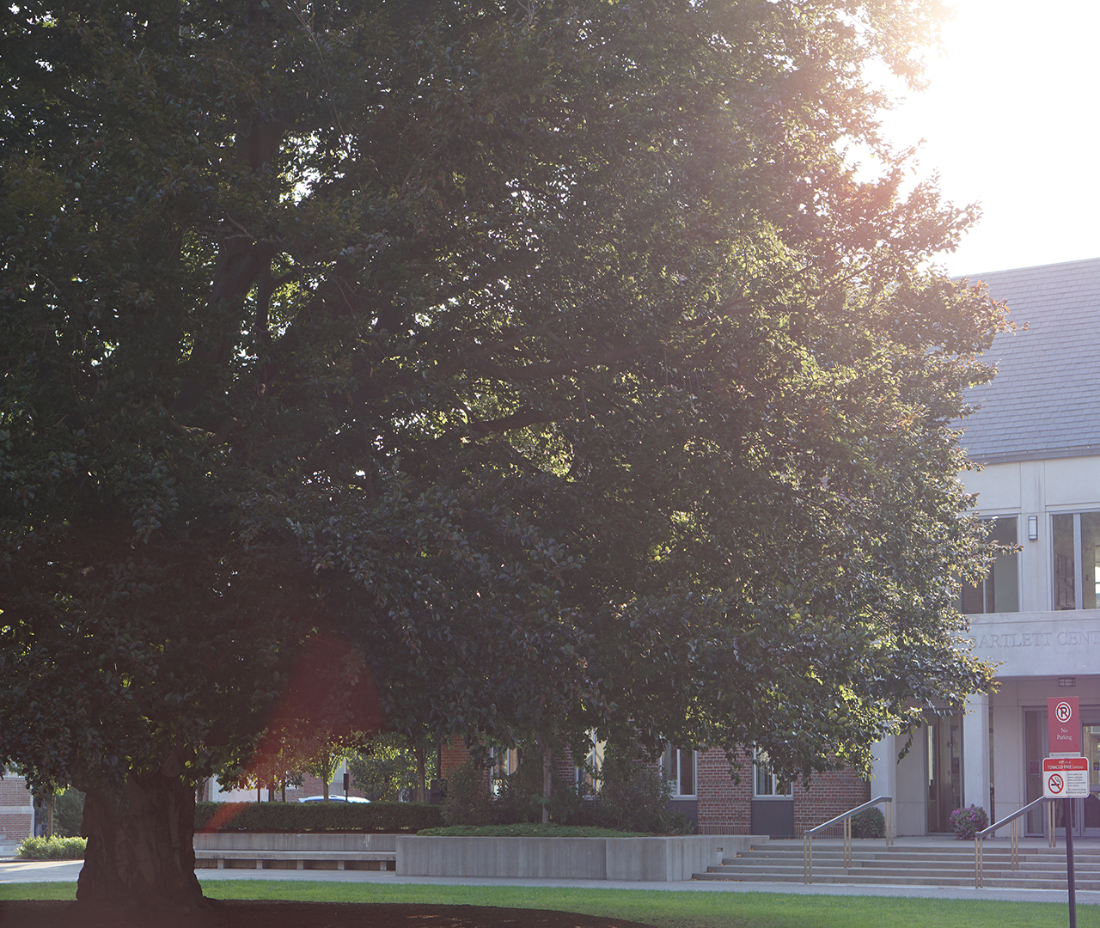
WPIn Love, Status Update
Craig Bursey
Griffin Cecil
Jonella Esposito
Jimmy Tran

Slide 2
Group Roles
Jimmy Tran,
programmer
Griffin Cecil,
designer
Jonella Esposito,
artist
Craig Bursey,
secondary programmer/designer

Slide 3
What’s in Store for WPIn Love
Breaking from the default
Font
Music
Adding special effects

Slide 4
What to cut?
The most dispensable aspects
of the game, in order:
Large chunks of dialogue (e.g. professor’s speech, dinner conversation)
One emotion asset per character

